Slide 1
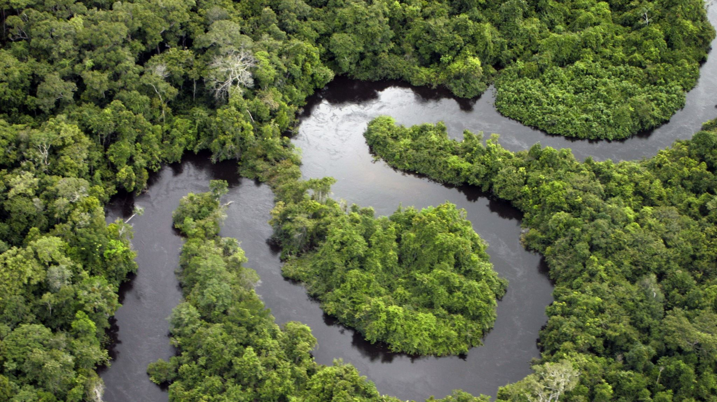
Optimising Bioeconomy Logistics For The Amazon Region
Progress meeting: 21/06/2024
Group 6: Mamoun, Chenlu, Abdul, Mai, Mia, Bhumin

Slide 2






Overview
01
Strategy Outline
Modelling results and output
02
03
Criteria assessment and weighting
04
Next week plan

Slide 3







Team Contributions
Modelling methods
Technical report
Everyone
Mia, Mai
Abdul, Mamoun
Bhumin
Chenlu
Criteria quantification

Slide 4

Strategy Outline
Modelling based on strategy

Slide 5



Strategies formation
Literature Review
List of comparative criteria
Modelling
Real World based implementation of selected strategies
Comparative criteria impact quantification
Implementation the model based on the scope set
Methodology to quantify the impact and weight the criteria
Strategy evaluation
Visualisation of critical elements of the recommended solution
Last Week
This Week
Next Week

Slide 6
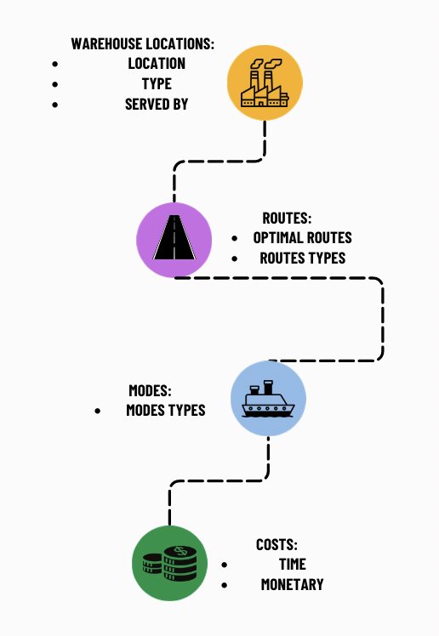
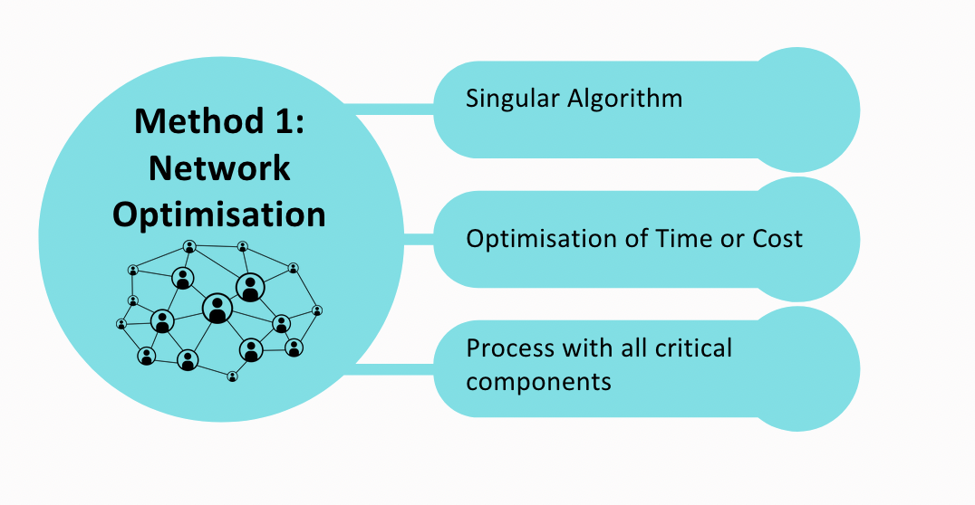
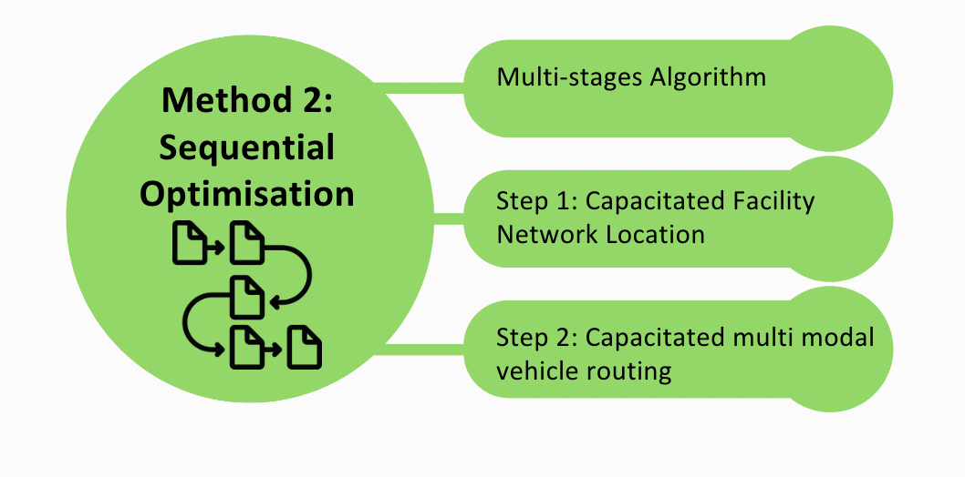
Modelling Approaches-recap
Critical Components

Slide 7

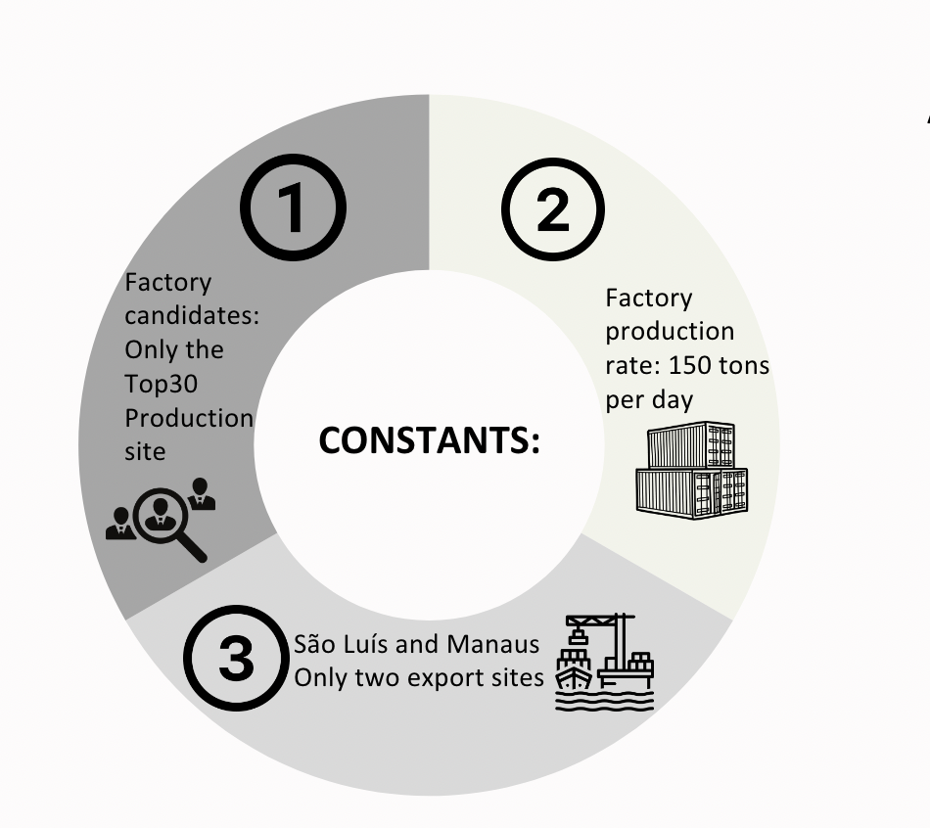
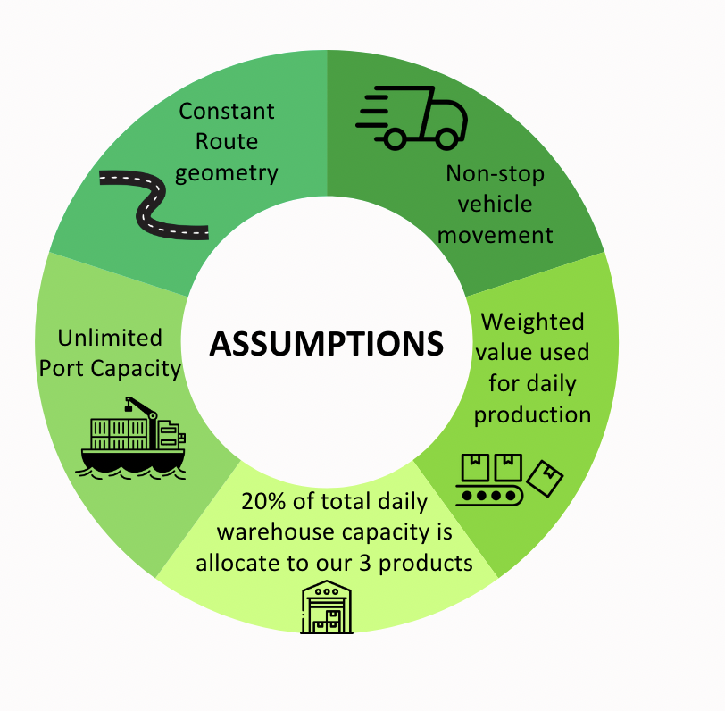
Modelling: Standardisation

Slide 8

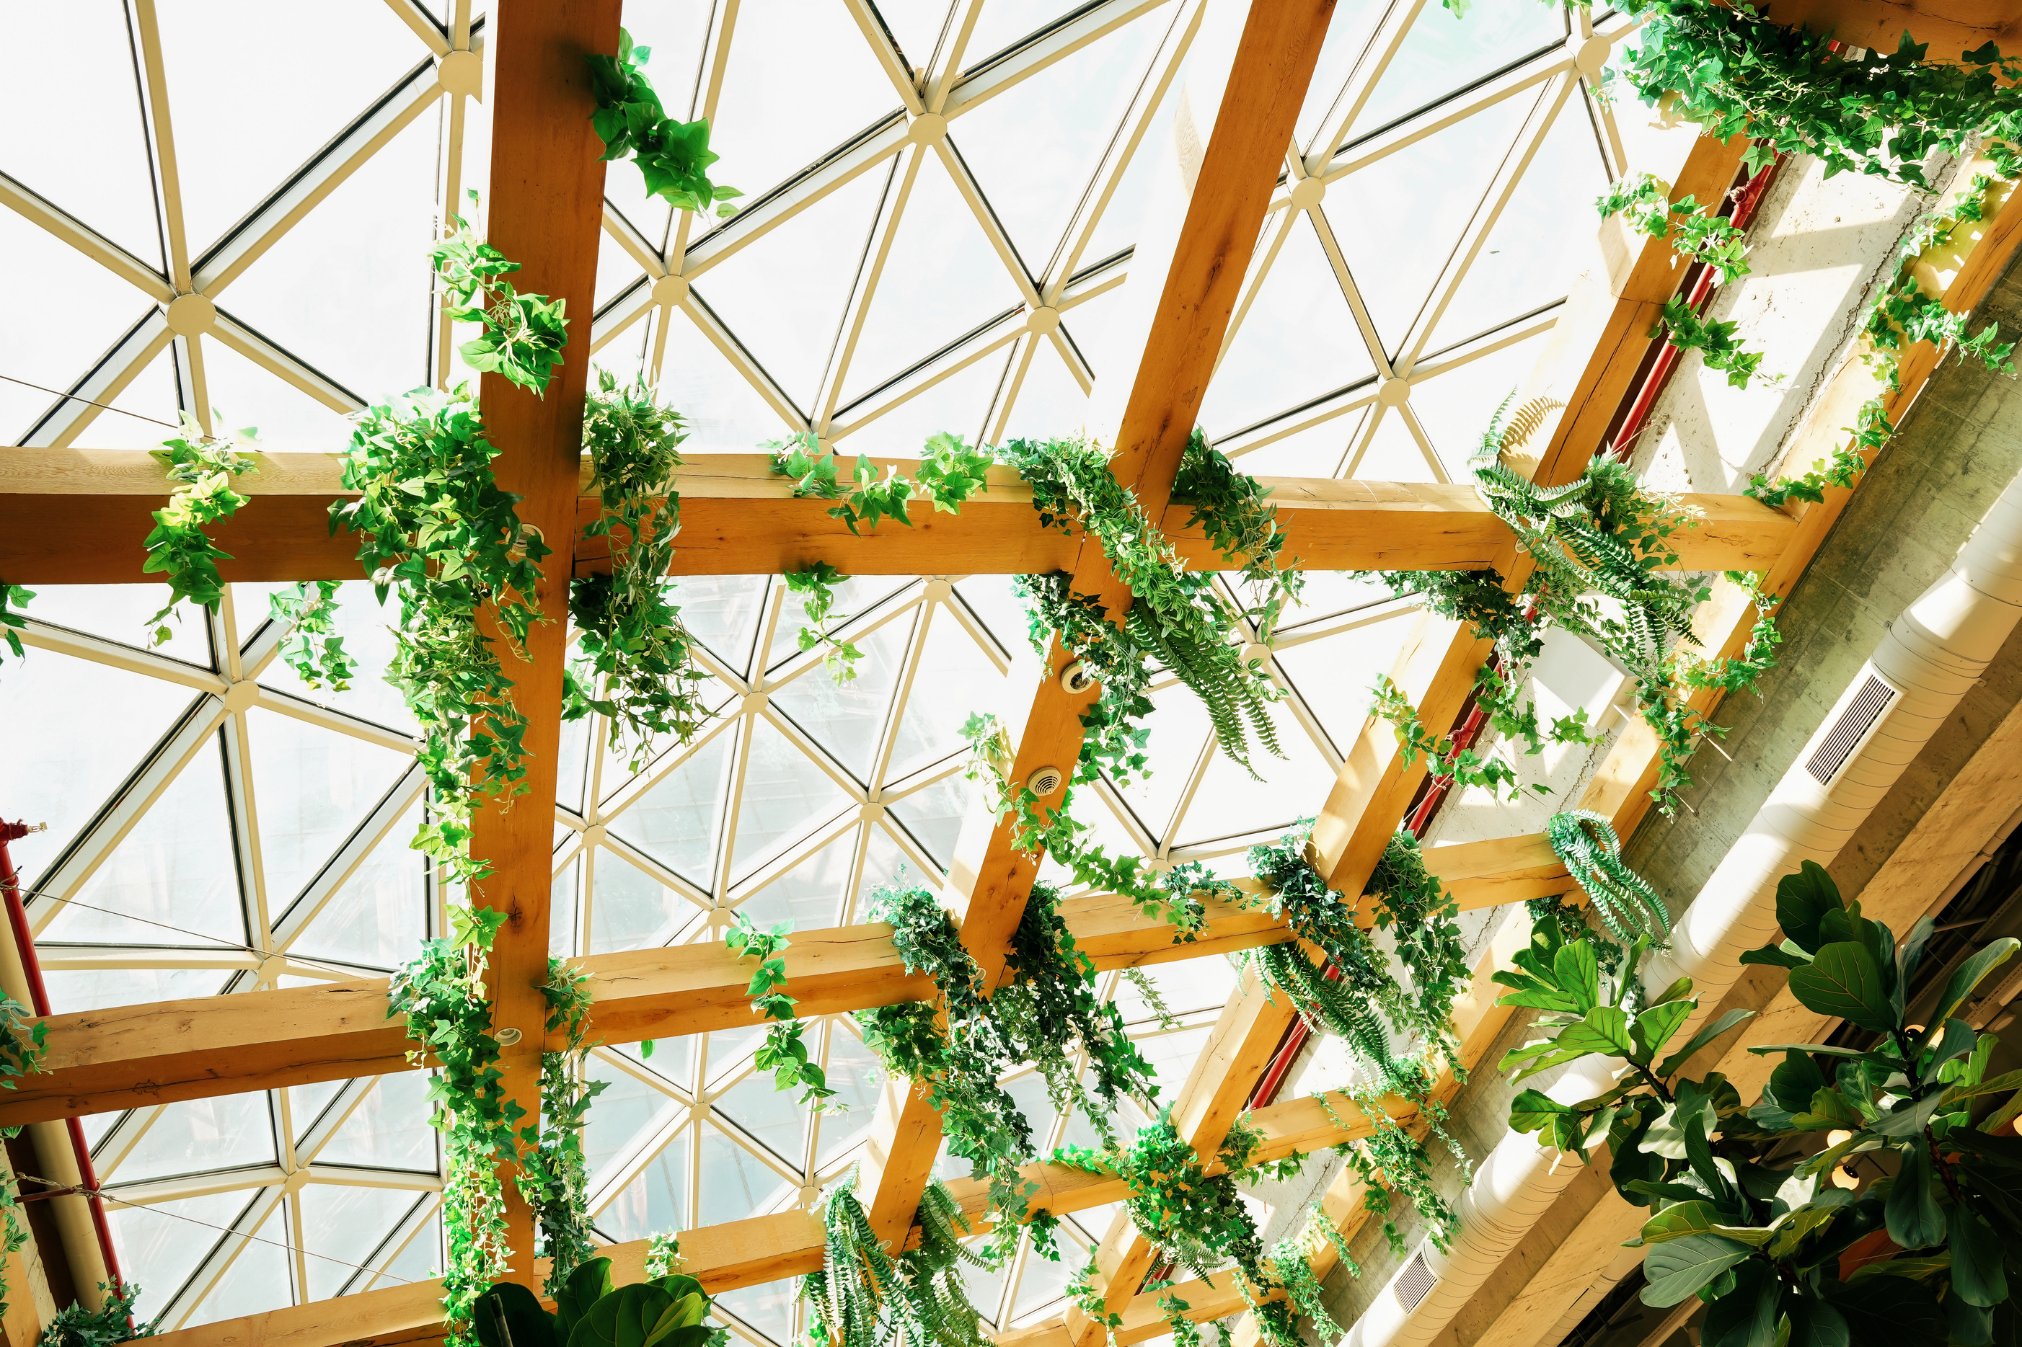



Method-1
A systematic approach to global solutions
Warehouse Location
Mode choice
Allocation/Distribution
Consider the appropriate location and type of warehouse based on the production quantity and origin of the three products.
Selection of appropriate modes of transport for the shipment of the respective products, considering the optimization function.
Allocation of ports, warehouses and production sites.
Source,
k
Mode, m
Factory,
type j at town i
Mode, n
Port,
l

Slide 9

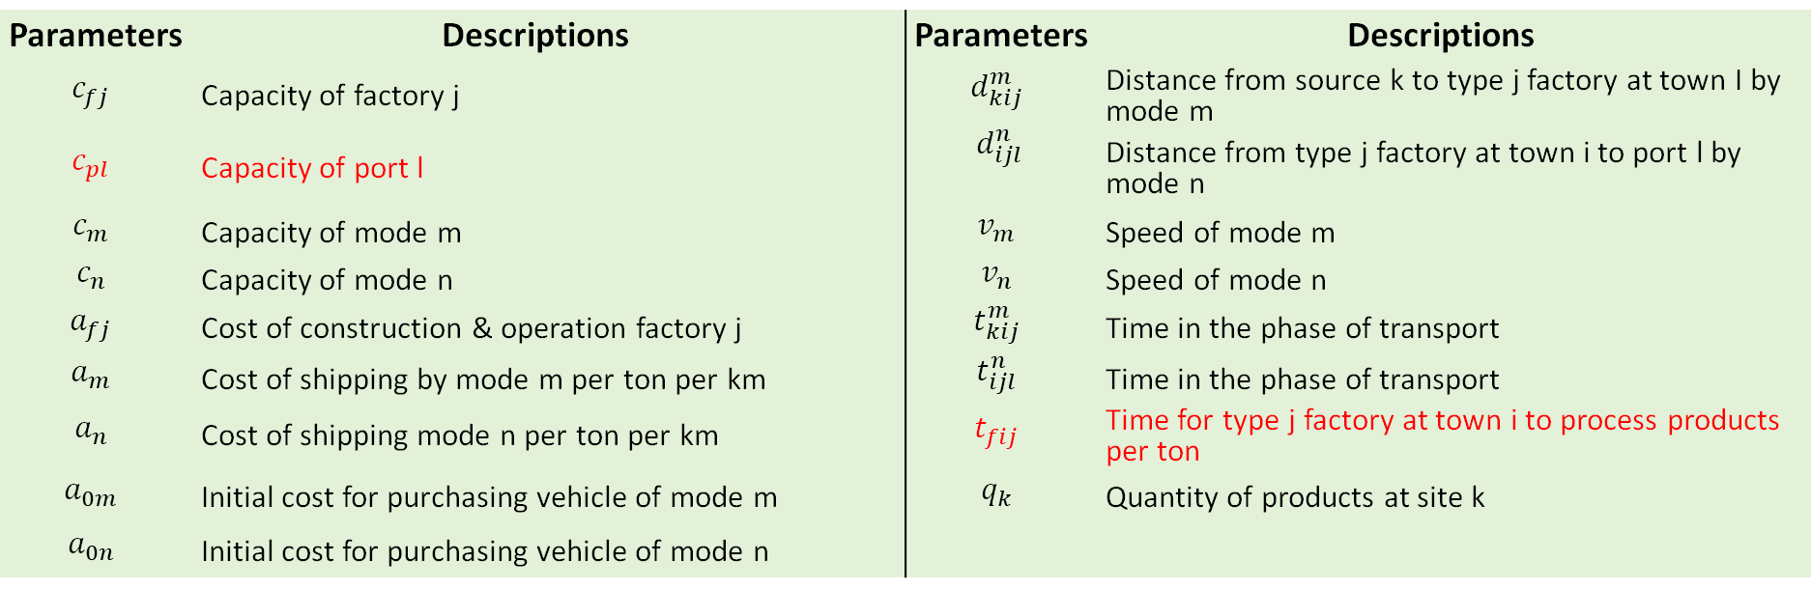
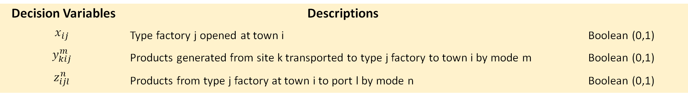
Modelling – Mathematical Formulation
Decision Variables | Descriptions
$$x_{ij}$$ | Type factory j opened at town i | Boolean (0,1)
$$y_{kij}^{m}$$ | Products generated from site k transported to type j factory to town i by mode m | Boolean (0,1)
$$z_{ijl}^{n}$$ | Products from type j factory at town i to port l by mode n | Boolean (0,1)
Parameters | Descriptions | Parameters | Descriptions
$$c_{fj}$$ | Capacity of factory j | $$d_{kij}^{m}$$ | Distance from source k to type j factory at town I by mode m
$$c_{pl}$$ | Capacity of port l | $$d_{ijl}^{n}$$ | Distance from type j factory at town i to port l by mode n
$$c_{m}$$ | Capacity of mode m | $$v_{m}$$ | Speed of mode m
$$c_{n}$$ | Capacity of mode n | $$v_{n}$$ | Speed of mode n
$$a_{fj}$$ | Cost of construction & operation factory j | $$t_{kij}^{m}$$ | Time in the phase of transport
$$a_{m}$$ | Cost of shipping by mode m per ton per km | $$t_{ijl}^{n}$$ | Time in the phase of transport
$$a_{n}$$ | Cost of shipping mode n per ton per km | $$t_{fij}$$ | Time for type j factory at town i to process products per ton
$$a_{0m}$$ | Initial cost for purchasing vehicle of mode m | $$q_{k}$$ | Quantity of products at site k
$$a_{0n}$$ | Initial cost for purchasing vehicle of mode n

Slide 10
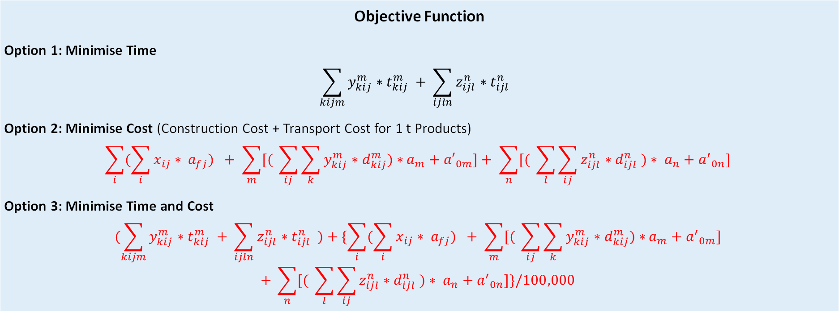
Modelling – Mathematical Formulation
Objective Function
Option 1: Minimise Time
$$\sum_{kijm}{y_{kij}^{m}∗t_{kij}^{m} }+ \sum_{ijln}{z_{ijl}^{n}∗t_{ijl}^{n} }$$
Option 2: Minimise Cost (Construction Cost + Transport Cost for 1 t Products)
$$\sum_{i}{(\sum_{i}{x_{ij}∗ a_{fj}) } }+ \sum_{m}{[( }\sum_{ij}{\sum_{k}{y_{kij}^{m}∗d_{kij}^{m})∗}}a_{m}+{a′}_{0m}]+ \sum_{n}{[( }\sum_{l}{\sum_{ij}{z_{ijl}^{n}}}∗d_{ijl}^{n} )∗ a_{n}+{a^{′}}_{0n}]$$
Option 3: Minimise Time and Cost
$$(\sum_{kijm}{y_{kij}^{m}∗t_{kij}^{m} }+ \sum_{ijln}{z_{ijl}^{n}∗t_{ijl}^{n} )}+\{\sum_{i}{(\sum_{i}{x_{ij}∗ a_{fj}) } }+ \sum_{m}{[( }\sum_{ij}{\sum_{k}{y_{kij}^{m}∗d_{kij}^{m})∗}}a_{m}+{a^{′}}_{0m}]$$ $$+ \sum_{n}{[( }\sum_{l}{\sum_{ij}{z_{ijl}^{n}}}∗d_{ijl}^{n} )∗ a_{n}+{a^{′}}_{0n}]\}/100,000$$

Slide 11
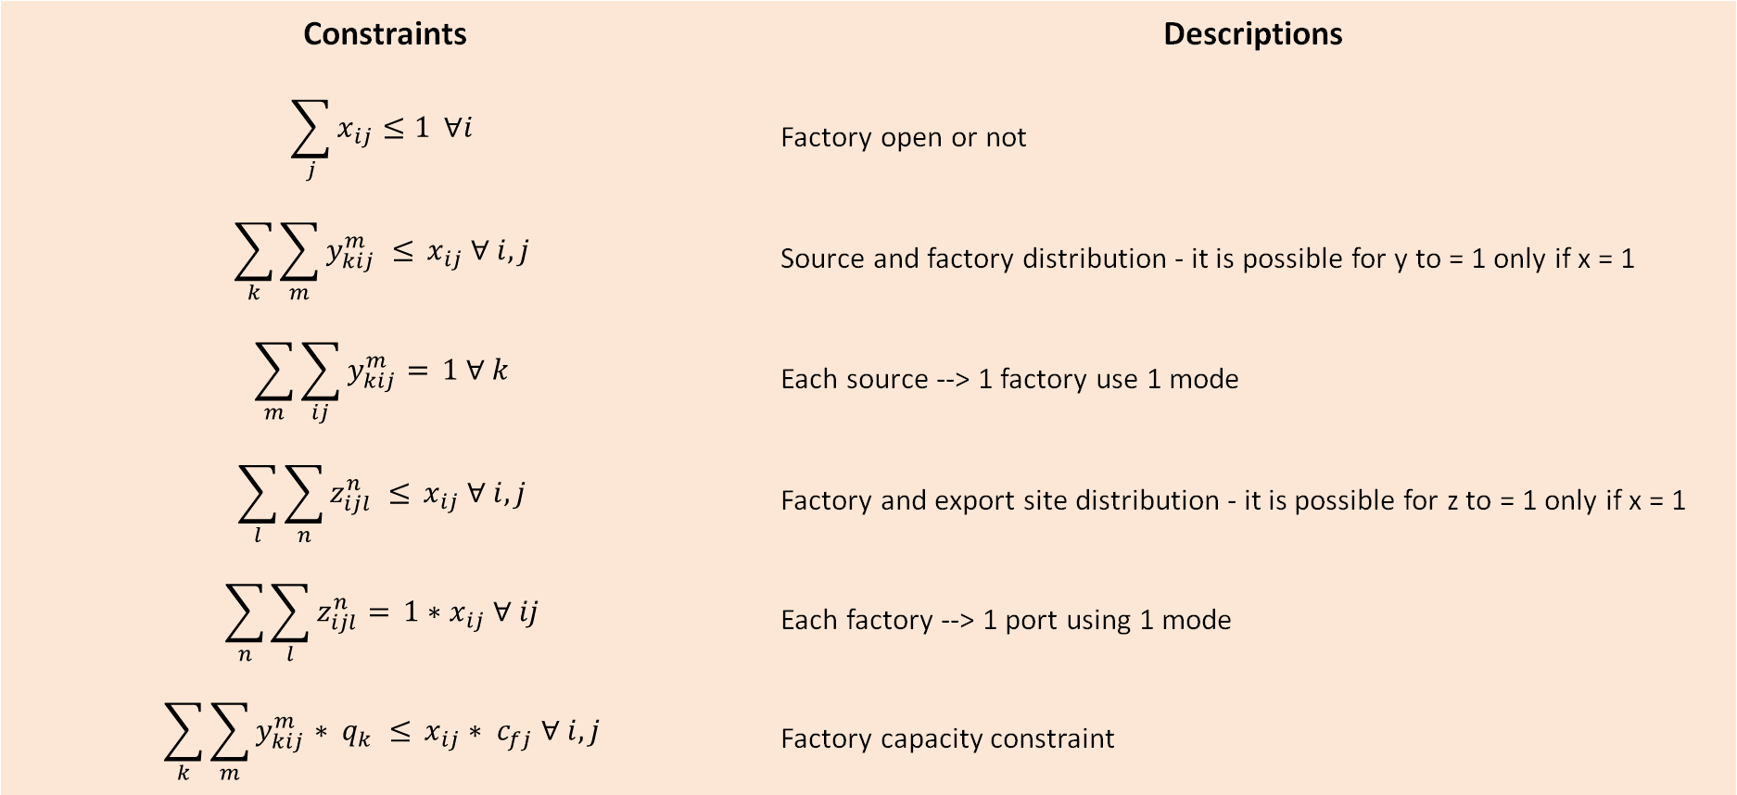
Modelling – Mathematical Formulation
Constraints | Descriptions
$$\sum_{j}{x_{ij}≤1} ∀i$$ | Factory open or not
$$\sum_{k}{\sum_{m}{y_{kij}^{m} ≤}} x_{ij} ∀ i,j$$ | Source and factory distribution - it is possible for y to = 1 only if x = 1
$$\sum_{m}{\sum_{ij}{y_{kij}^{m}=}} 1 ∀ k$$ | Each source --> 1 factory use 1 mode
$$\sum_{l}{\sum_{n}{z_{ijl}^{n} ≤}} x_{ij} ∀ i,j$$ | Factory and export site distribution - it is possible for z to = 1 only if x = 1
$$\sum_{n}{\sum_{l}{z_{ijl}^{n}=}} 1∗x_{ij} ∀ ij$$ | Each factory --> 1 port using 1 mode
$$\sum_{k}{\sum_{m}{y_{kij}^{m}∗ q_{k} ≤}} x_{ij}∗ c_{fj} ∀ i,j$$ | Factory capacity constraint

Slide 12
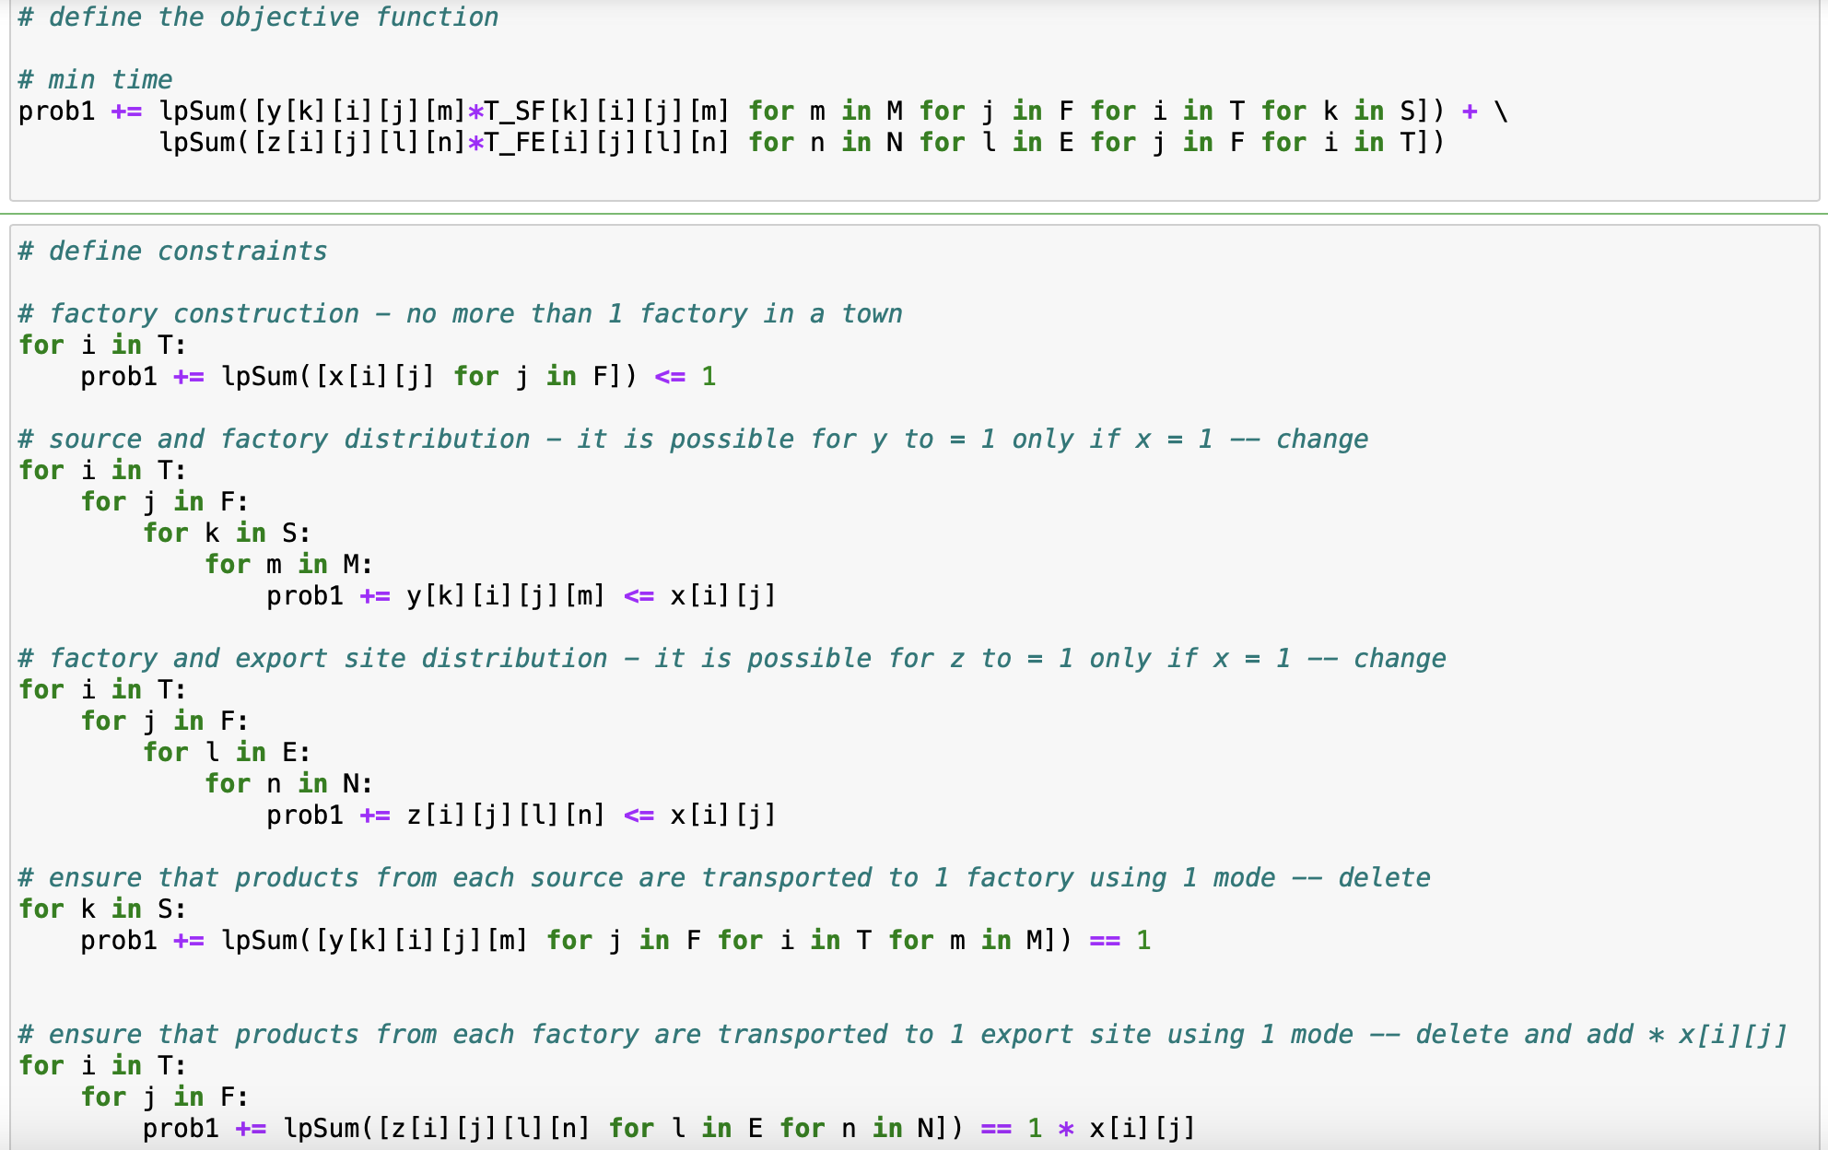
Modelling – Mathematical Formulation

Slide 13
Method-2
Solve the warehouse siting problem and the shortest path problem separately.
Warehouse Location
Routing problem
Feasibility analysis
Use the weighted route distance to determine the location of warehouses, considering the warehouse types, warehouse possibility, and mode cost.
Finding the shortest paths between supply chain nodes at all echelons through capacitated vehicle routing algorithms.
Checking the feasibility of the results and reaching a final solution.

Slide 14
Modelling – Facility Location
Constraints:
All products must be delivered
Facilities are open if used
Prevent zero distance trip
Each facility capacity must not be exceeded
Certain number range of facilities are used
Only one mode for each OD
Each town deliver to one factory only
If mode is non-refrigerated, under 24-hour travel time
Inputs:
Town & Candidates factory location
Town daily production
Factory daily production
Mode's characteristic
River & Road OD matrix
Output:
Chosen facility locations
Town serving each facility
Mode used
Total cost and time
Objective functions:
Option 1- Minimise cost
Option 2- Minimise time
Option 3- Minimise weighted cost and time

Slide 15
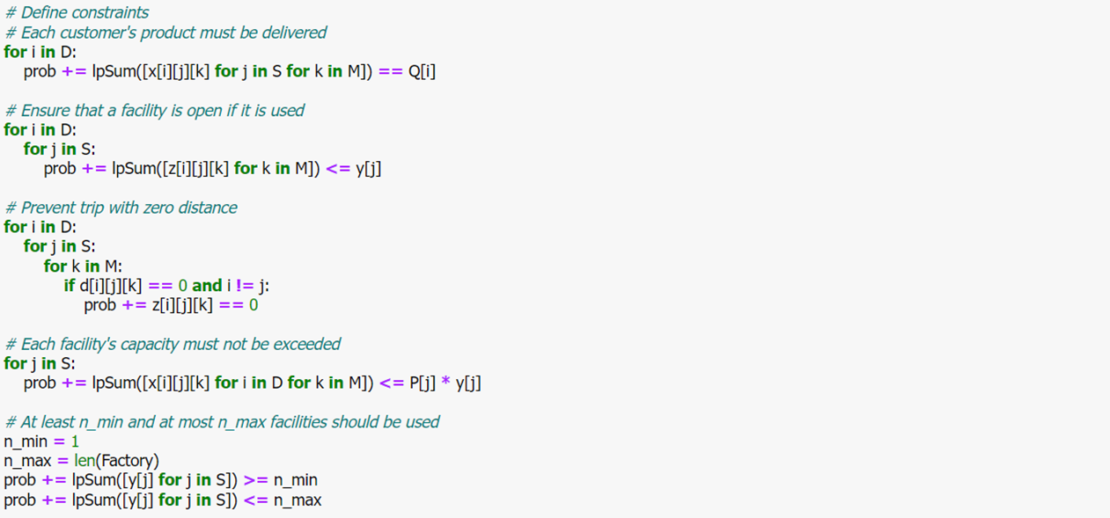
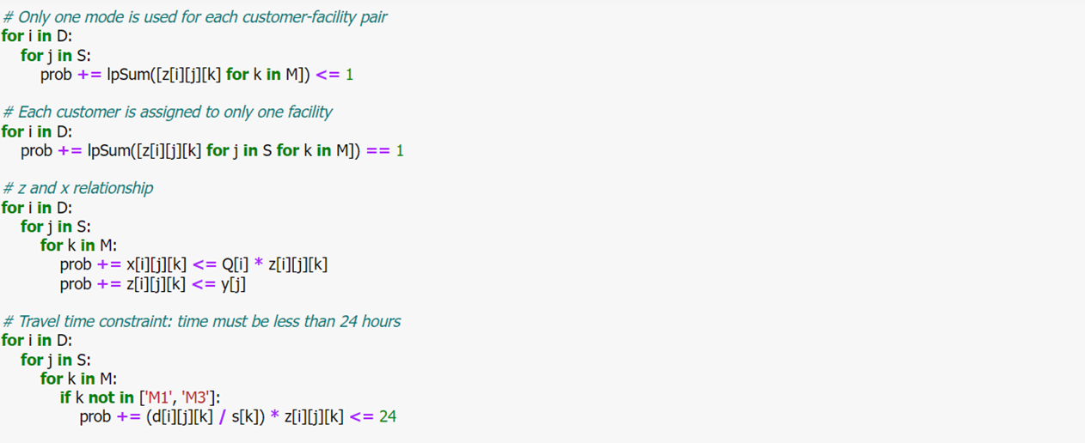
Modelling – Facility Location

Slide 16
Modelling – Facility Location
Inputs:
Factory & Port location
Factory daily production
Mode's characteristic
River, Road & Rail OD matrix
Output:
Factory serving each Port
Mode used
Total Echelon 2 cost and time
Total Network cost and time
Objective functions:
Option 1- Minimise cost
Option 2- Minimise time
Option 3- Minimise weighted cost and time
Constraints:
All products must be delivered
Prevent zero distance trip
If mode is non-refrigerated, under 24-hour travel time

Slide 17
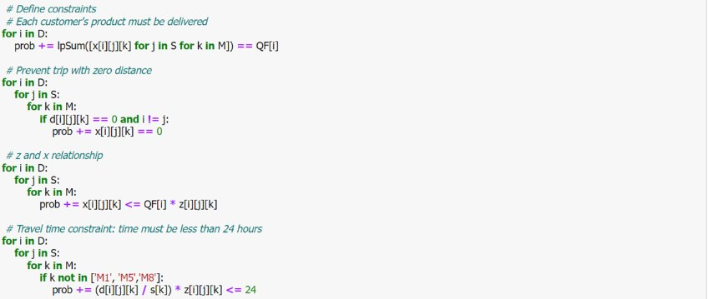
Modelling – Port Routing

Slide 18
Modelling results
Models output of 2 methods

Slide 19
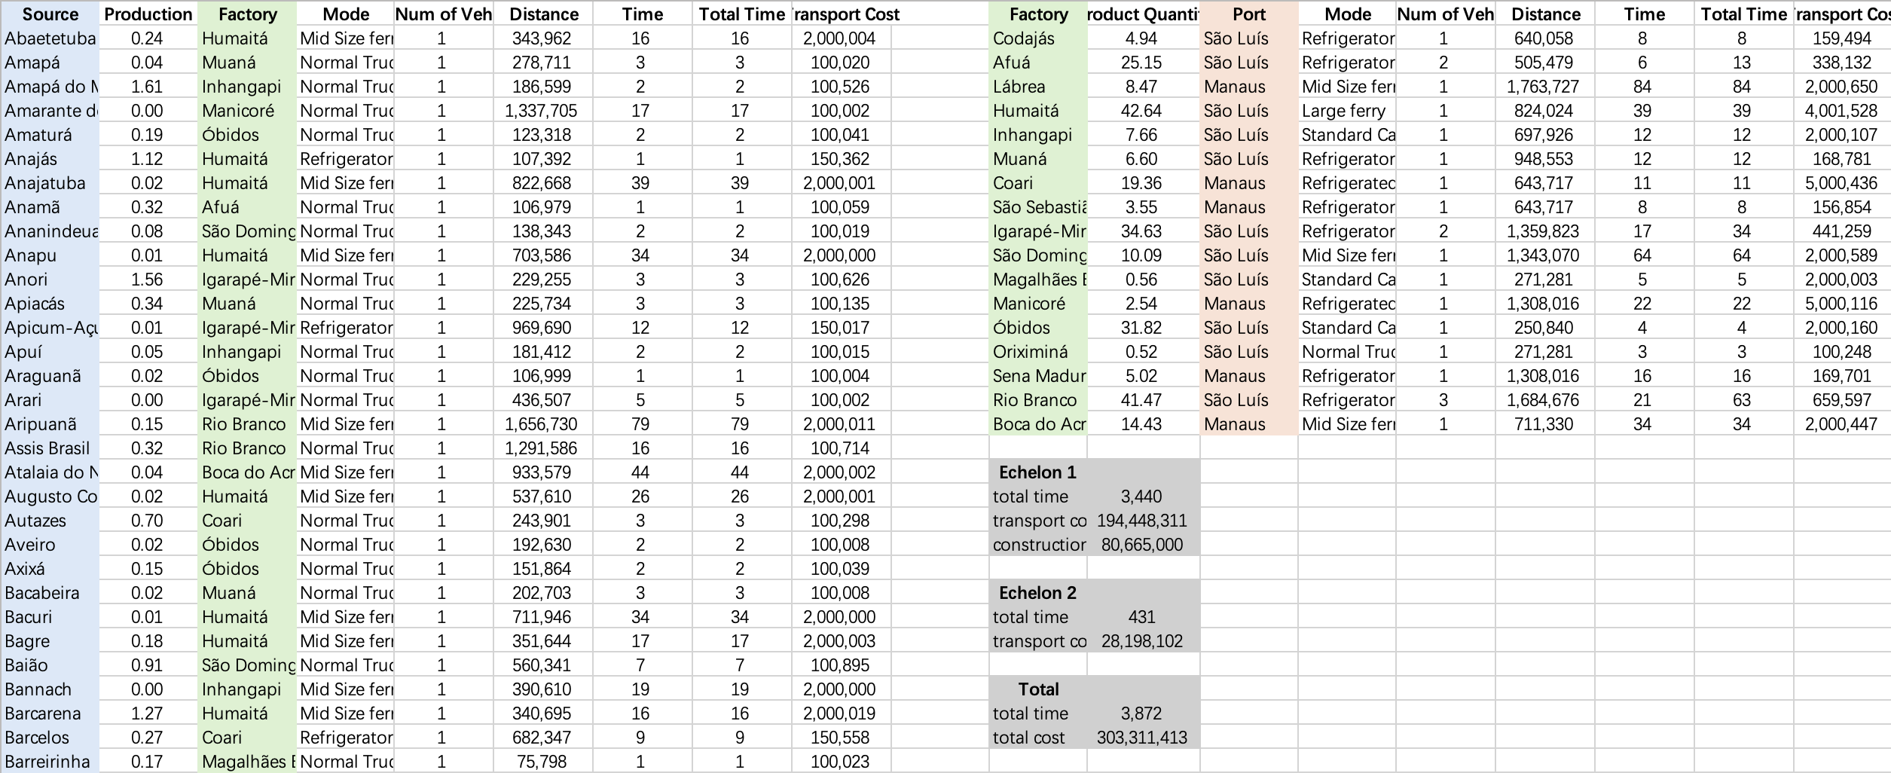
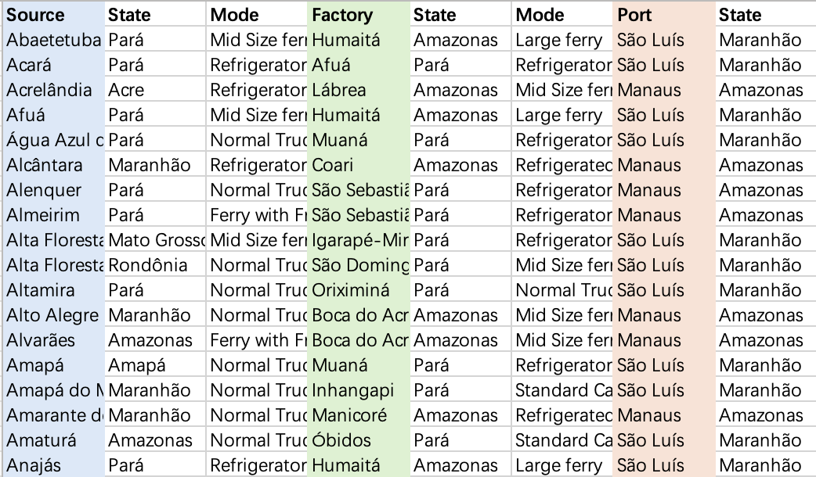
Modelling – Method 1 -A systematic approach to global solutions
Output (Minimise Time):
Source,
k
Mode, m
Factory,
at town i
Mode,
n
Port,
l
Total time: 3,872 hours
Total cost: 303,311,413 dollars

Slide 20
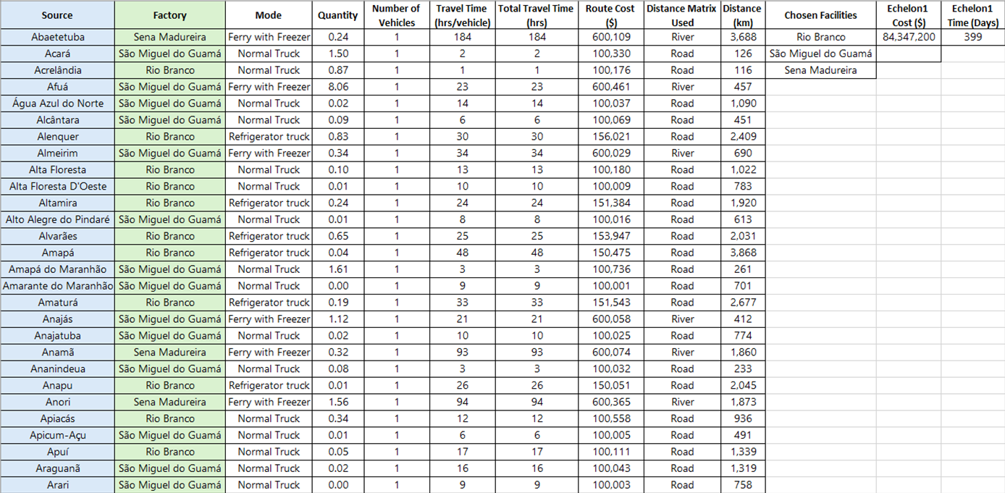
Modelling – Method 2 -A sequential approach to echelon solutions
Output (Echelon1: Facility Location: Minimise cost):
Source
Modem
Factory

Slide 21
Modelling – Method 2 -A sequential approach to echelon solutions
Output (Echelon2: Port Routing: Minimise cost):
Factory
Modem
Port
Output (Network: Output Combinations):
Objective Functions
Min.Cost
Min.Time
Min.
CostTime
Min.Cost
Min.Time
Min.
CostTime
Min.Cost
Min.Time
Min.
CostTime
Min.Cost
Min.Time
Min.
CostTime

Slide 22
Criteria analysis
Methodology to quantify the impact and weigh the developed criteria

Slide 23

Criteria Analysis
Construction
and
Maintenance
Cost
Construction and Maintenance Cost
Digital
Access
Developing Amazon infrastructure is costly due to terrain and weather; using existing rivers reduces costs and maintains efficiency.
Potential for Volume Growth
Scalable transport for the Amazon bioeconomy requires enhanced waterway capacity and frequent, quality product transport.
Digital Access
Criteria 1-4
Enhancing Amazon's digital infrastructure boosts logistics efficiency, and sustainability.
Energy Efficiency
Electrification and renewables in Amazon transport minimize emissions and promote sustainability.
Potential for
Volume
Growth
Energy
Efficiency

Slide 24
Criteria Analysis
Environmental Impact
Environmental
Impact
Safety and
Security
Sustainable Amazon transport focuses on reducing pollution and protecting biodiversity through electric and waterway modes.
Sensitivity to Climate events
The Amazon's climate challenges transportation, particularly for perishables, requiring consistent conditions despite weather disruptions.
Safety and Security
Criteria 5-8
To ensure the safety of bioeconomy products and infrastructure, robust security measures, comprehensive safety regulations, and extensive training are essential to mitigate risks from theft, damage, disasters, and attacks.
Job Creation
Sensitivity to
Climate events
Job
Creation
Developing transportation infrastructure in the Amazon boosts jobs and GDP through sustainable practices like zero deforestation.

Slide 25
Scoring System
Aspects | Indicators | Calculated | Weight
Economic | Construction and Maintenance cost | 0.237 | 19.67%
 | Digital access | 0.126 | 10.46%
 | Potential volume growth | 0.078 | 6.47%
Social | Safety and security | 0.409 | 33.94%
 | Job creation | 0.07 | 5.81%
Environmental | Environmental Impact | 0.098 | 8.13%
 | Energy efficiency | 0.124 | 10.29%
 | Sensitivity to climate change | 0.063 | 5.23%
 |  | 1.205 | 100.00%
(Elita Amrina et al. / Procedia Manufacturing 43 (2020) 674–681)

Slide 26
Methodology
Construction
and
Maintenance
Cost
Construction and Maintenance Cost
Digital
Access
Developing Amazon infrastructure is costly due to terrain and weather; using existing rivers reduces costs and maintains efficiency.
Potential for Volume Growth
Scalable transport for the Amazon bioeconomy requires enhanced waterway capacity and frequent, quality product transport.
Digital Access
Criteria 1-4
Enhancing Amazon's digital infrastructure boosts logistics efficiency, and sustainability.
Energy Efficiency
Electrification and renewables in Amazon transport minimize emissions and promote sustainability.
Potential for
Volume
Growth
Energy
Efficiency

Slide 27
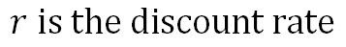
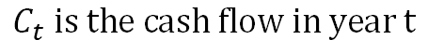
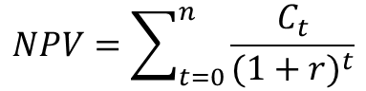
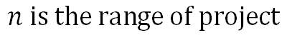
Construction and maintenance
Calculator
 | Year | 0 | 1 | 2 | 3 | 10
 | Cash Flow | US$ 4,745,000.00 | US$ 45,000.00 | US$ 45,000.00 | US$ 45,000.00 | US$ 45,000.00
 | Discounted cash flow | US$ 4,745,000.00 | US$ 42,857.14 | US$ 40,816.33 | US$ 38,872.69 | US$ 27,626.10
 | Total discounted cash flow | US$ 9,490,000.00 | US$ 85,714.29 | US$ 81,632.65 | US$ 77,745.38 | US$ 55,252.19
 | Total | US$ 9,490,000.00 | US$ 9,575,714.29 | US$ 9,657,346.94 | US$ 9,735,092.32 | US$ 10,184,956.14
Number of facility | 2 | Total Cost | 10184956.14 | Score | 100.00
 | 3 |  | 15277434.22 |  | 96.43
 | 12 |  | 61109736.86 |  | 64.29
 | 17 |  | 86572127.22 |  | 46.43
 | 30 |  | 152774342.15 |  | 0.00
$$NPV=\sum_{t=0}^{n}{\frac{C_{t}}{{(1+r)}^{t}}}$$
Input:
number of facilities
Construction fees
Maintenance fees
$$C_{t} is the cash flow in year t$$
$r$ $is the discount rate$
$n$ $is the range of project$
Notes:
NPV: Net present value discounting method
Steps1 : identify cash flow, investment in different year e.g. construction fee + maintenance fees
Step2: choose the discount rate base on the risk and opportunity cost of the investment
Step3: for each period, divide the cash flow by (1+r)^t to find its present value.
Step4: sum the present values.
The NPV discounting method helps investors and managers evaluate the attractiveness of an investment or project. After the project is completed we can evaluate the progress based on the revenue of the warehouse.
For this current stage, we can use this to look at the prices that different quantities and types of warehouses cost and assign them scores based on the different prices, incorporating the scores into the overall strategy comparison

Slide 28
Methodology
Construction
and
Maintenance
Cost
Digital
Access
Construction and Maintenance Cost
Developing Amazon infrastructure is costly due to terrain and weather; using existing rivers reduces costs and maintains efficiency.
Potential for Volume Growth
Scalable transport for the Amazon bioeconomy requires enhanced waterway capacity and frequent, quality product transport.
Digital Access
Criteria 1-4
Enhancing Amazon's digital infrastructure boosts logistics efficiency, and sustainability.
Energy Efficiency
Electrification and renewables in Amazon transport minimize emissions and promote sustainability.
Potential for
Volume
Growth
Energy
Efficiency

Slide 29
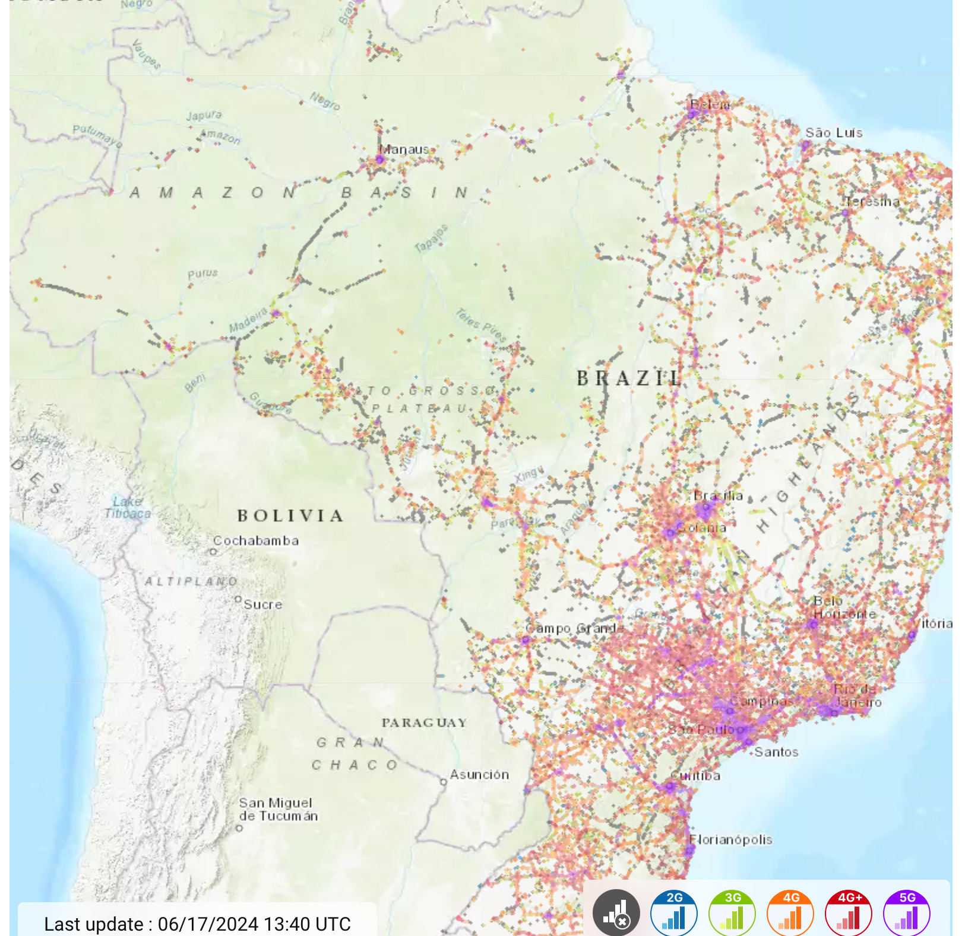
Digital access
The improvement will be assessed incrementally with a factor of 0.2.
If the factory is built in a poor connected town, digital access score will be more valuable.
If the factory is built in a well-connected town, digital access score will be lower.
The factors will be scaled to a 100 score and then averaged.

Slide 30
Methodology
Construction
and
Maintenance
Cost
Construction and Maintenance Cost
Digital
Access
Developing Amazon infrastructure is costly due to terrain and weather; using existing rivers reduces costs and maintains efficiency.
Potential for Volume Growth
Scalable transport for the Amazon bioeconomy requires enhanced waterway capacity and frequent, quality product transport.
Digital Access
Criteria 1-4
Enhancing Amazon's digital infrastructure boosts logistics efficiency, and sustainability.
Energy Efficiency
Electrification and renewables in Amazon transport minimize emissions and promote sustainability.
Potential for
Volume
Growth
Energy
Efficiency

Slide 31
Energy efficiency
Vehicle Type | Energy Consumption (kWh per ton-km) | Fuel Efficiency (L per ton-km) | Emission (kg CO2 per ton-km) | Normalised Energy Consumption | Normalised Fuel Efficiency | Normalised Emission | Normalised Energy Efficiency | Higher score = Higher efficiency
Freezer Boat | 0.10 | 0.03 | 0.00 | 0.01 | 0.01 | 0.00 | 0.38 | 99.62
Ferry with Freezer | 0.15 | 0.05 | 0.11 | 0.01 | 0.01 | 0.02 | 1.27 | 98.73
Mid-Size ferry | 0.12 | 0.04 | 0.11 | 0.01 | 0.01 | 0.02 | 1.15 | 98.85
Large ferry | 0.09 | 0.03 | 0.11 | 0.01 | 0.01 | 0.02 | 1.03 | 98.97
River Barges | 0.08 | 0.03 | 0.11 | 0.01 | 0.01 | 0.02 | 0.97 | 99.03
Voadeiras | 0.05 | 0.02 | 0.08 | 0.00 | 0.00 | 0.01 | 0.69 | 99.31
Refrigerator truck (Mercedes-Benz Actros, Volvo FH with refrigerated body) | 0.80 | 0.24 | 0.07 | 0.05 | 0.05 | 0.01 | 3.51 | 96.49
Pickup Truck (Toyota Hilux, Ford Ranger) | 1.50 | 0.45 | 0.22 | 0.10 | 0.10 | 0.03 | 7.08 | 92.92
Vans (Mercedes-Benz Sprinter) | 1.20 | 0.36 | 0.11 | 0.08 | 0.08 | 0.02 | 5.27 | 94.73
Normal Truck (Volvo FMX, MAN TGS) | 0.60 | 0.18 | 0.05 | 0.04 | 0.04 | 0.01 | 2.59 | 97.41
Medium Propeller Planes (ATR 42) | 1.50 | 0.45 | 0.45 | 0.10 | 0.10 | 0.07 | 8.50 | 91.50
Large Cargo Planes (Boeing 737-400 Freighter) | 3.20 | 0.96 | 0.38 | 0.21 | 0.20 | 0.06 | 14.61 | 85.39
Helicopters (Sikorsky S-76) | 5.00 | 1.50 | 4.20 | 0.32 | 0.32 | 0.64 | 44.90 | 55.10
Standard Cargo Train | 0.50 | 0.15 | 0.26 | 0.03 | 0.03 | 0.04 | 3.51 | 96.49
Refrigerated Cargo | 0.70 | 0.21 | 0.30 | 0.04 | 0.04 | 0.05 | 4.52 | 95.48
 | 15.59 | 4.69 | 6.54 |  |  |  | 100

Slide 32
Criteria analysis
Environmental Impact
Environmental
Impact
Safety and
Security
Sustainable Amazon transport focuses on reducing pollution and protecting biodiversity through electric and waterway modes.
Sensitivity to Climate events
The Amazon's climate challenges transportation, particularly for perishables, requiring consistent conditions despite weather disruptions.
Safety and Security
Criteria 5-8
To ensure the safety of bioeconomy products and infrastructure, robust security measures, comprehensive safety regulations, and extensive training are essential to mitigate risks from theft, damage, disasters, and attacks.
Job Creation
Sensitivity to
Climate events
Job
Creation
Developing transportation infrastructure in the Amazon boosts jobs and GDP through sustainable practices like zero deforestation.

Slide 33
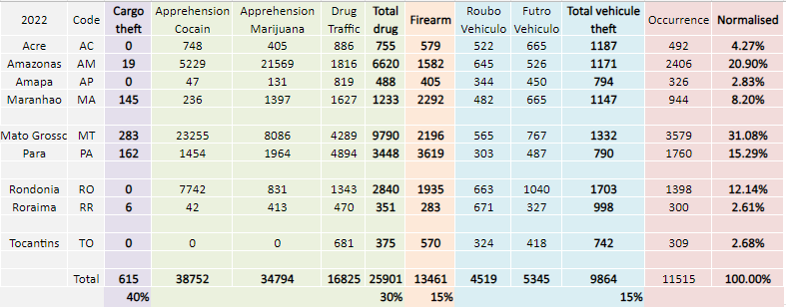
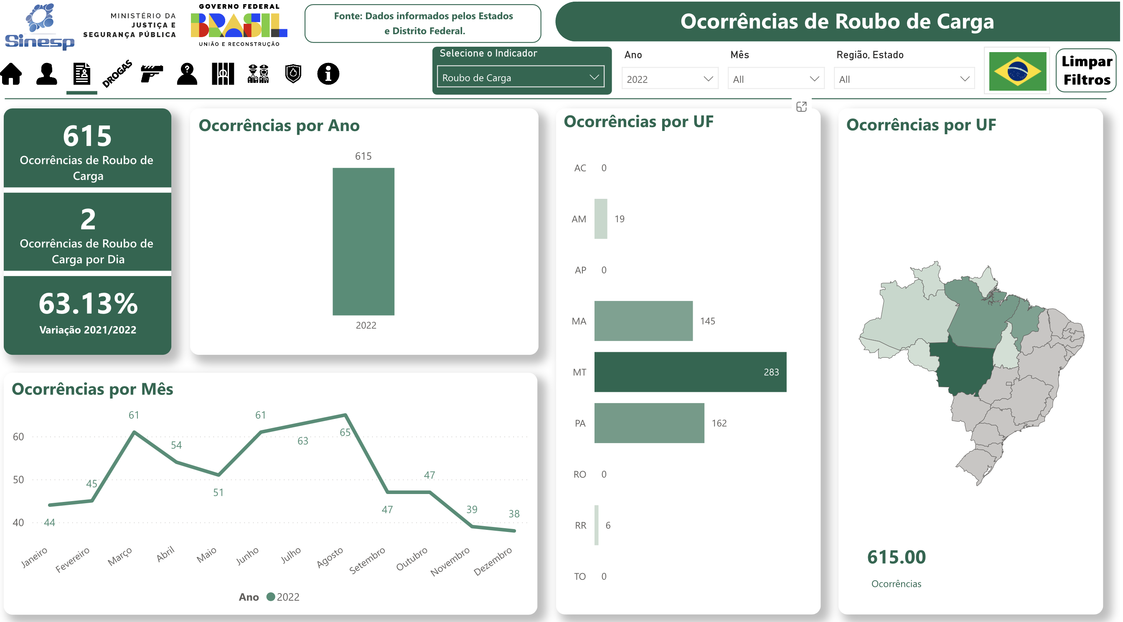
Safety and Security
State | Code | Security score
Acre | AC | 96
Amazonas | AM | 79
Amapá | AP | 97
Maranhão | MA | 92
Mato Grosso | MT | 69
Pará | PA | 85
Rondônia | RO | 88
Roraima | RR | 97
Tocantins | TO | 97
High score = High security
SS_AVG=AVERAGE(S_origin, S_destination)
TIME_Index = (TIME_SPEND_ON_THE_ROUTE - MIN_x) / (MAX_x - MIN_x)
SS_Index = 1 - TIME_Index
SS_SCORE = AVG * TIME_Index
SS_Strategy = AVERAGE(SS_SCORE)

Slide 34
Transport strategy assessment: Example
Aspects | Indicators | Calculated | Weight | Strategy 1 | Strategy 2 | Strategy 1 | Strategy 2
Economic | Construction and Maintenance cost | 0.237 | 19.67% | 95 | 92 | 18.7 | 18.1
 | Digital access | 0.126 | 10.46% | 88 | 91 | 9.2 | 9.5
 | Potential volume growth | 0.078 | 6.47% | 90 | 68 | 5.8 | 4.4
Social | Safety and security | 0.409 | 33.94% | 78 | 89 | 26.5 | 30.2
 | Job creation | 0.07 | 5.81% | 56 | 70 | 3.3 | 4.1
Environmental | Environmental Impact | 0.098 | 8.13% | 85 | 69 | 6.9 | 5.6
 | Energy efficiency | 0.124 | 10.29% | 67 | 69 | 6.9 | 7.1
 | Sensitivity to climate change | 0.063 | 5.23% | 69 | 75 | 3.6 | 3.9
Total |  | 1.205 | 100.00% |  |  | 80.9 | 82.9

Slide 35
Next Week Plan

Slide 36
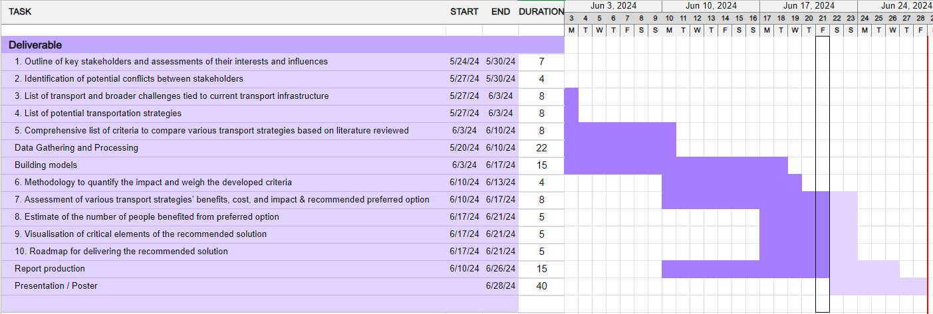
Project Plan

Slide 37
THANK YOU
Mia
Abdul
Chimin
Chenlu
Mamoun
Mai

